Slide 1

The Art of Documentation
and Readme.md
for Open Source Projects
@Ben_Hall
Ben@BenHall.me.uk
Katacoda.com

Slide 2
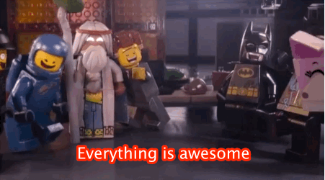

Slide 3
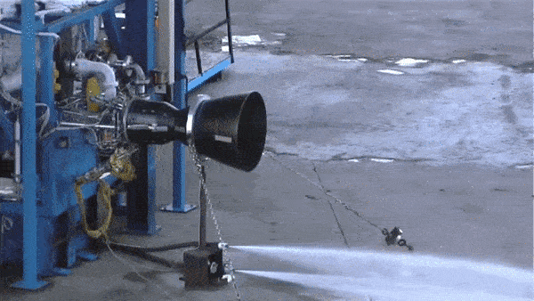

Slide 4
The Art of Documentation
and Readme.md
for Open Source Projects
@Ben_Hall
Ben@BenHall.me.uk
Katacoda.com

Slide 5



@Ben_Hall / Blog.BenHall.me.uk
WHO AM I?

Slide 6
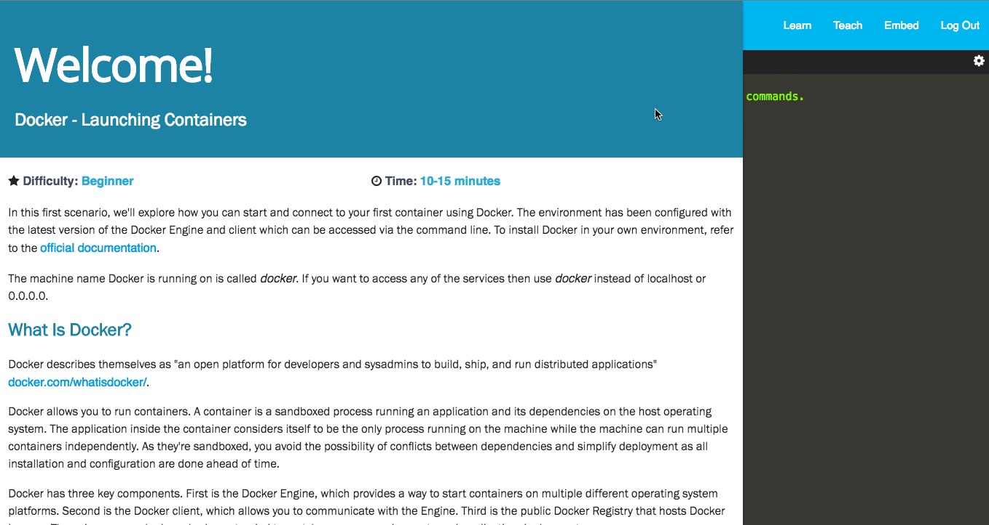
Learn via Interactive Browser-Based Labs
Katacoda.com

Slide 7
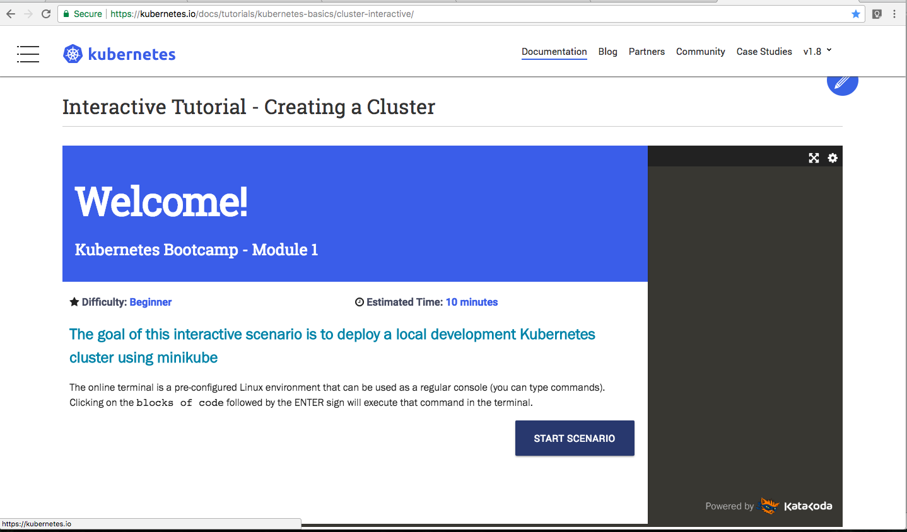

Slide 8
How documentation can transform the adoption of your product/project
Different to code documentation
Notes:
Internal OSS, External OSS, Commercial Products… all the same. It’s about adoption of ideas/concepts.

Slide 9
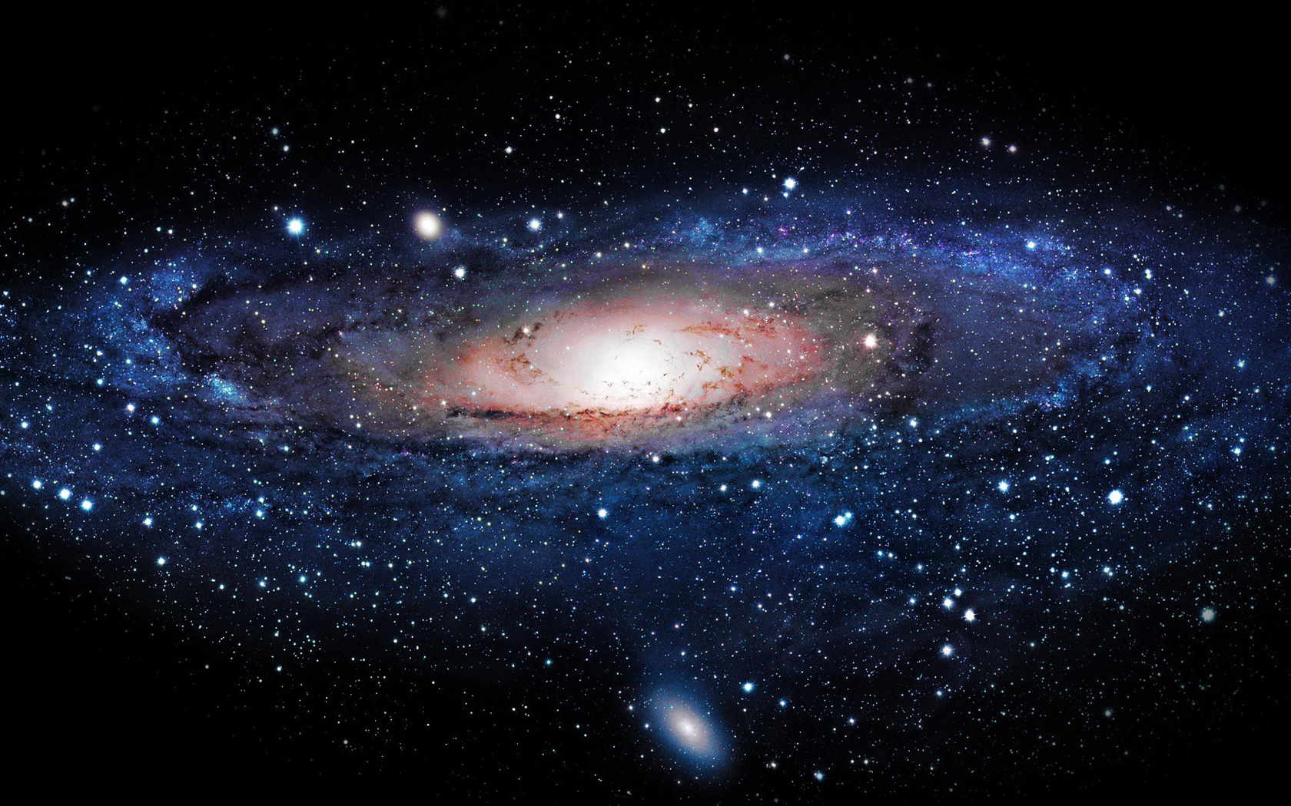
Where to begin?

Slide 10
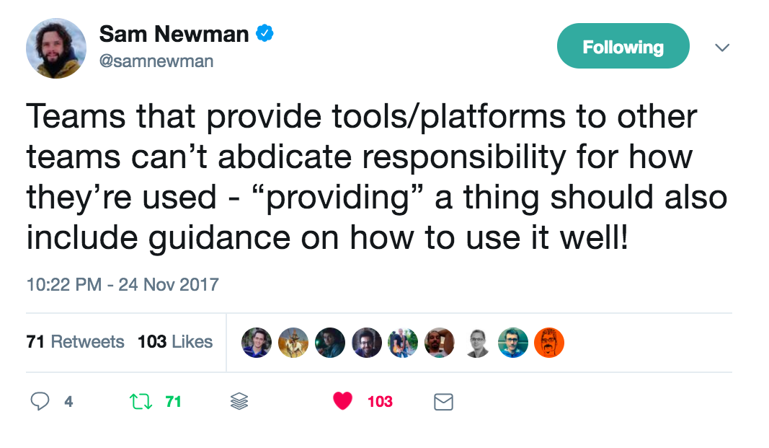
https://twitter.com/samnewman/status/934185375291060224

Slide 11
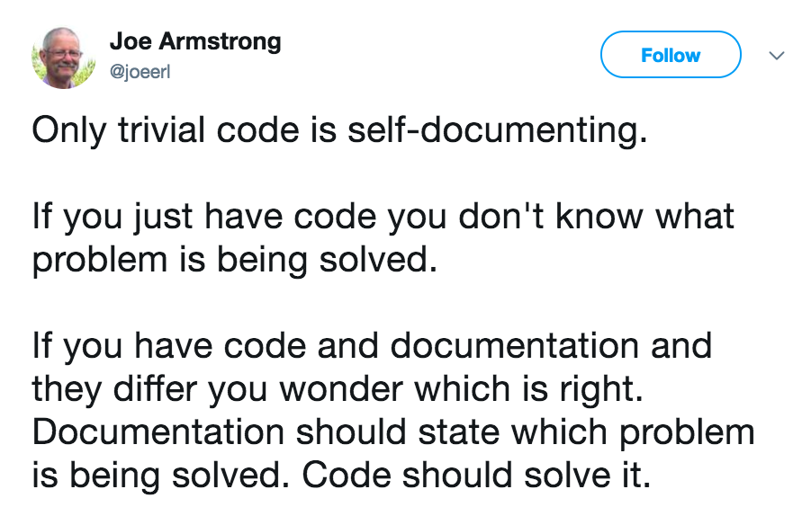
https://twitter.com/joeerl/status/934473378601291776?s=09

Slide 12
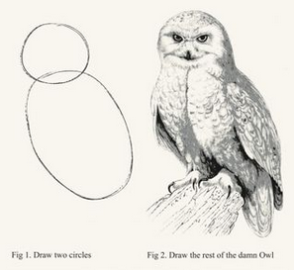
Notes:
Sadly most documentation is the Owl

Slide 13
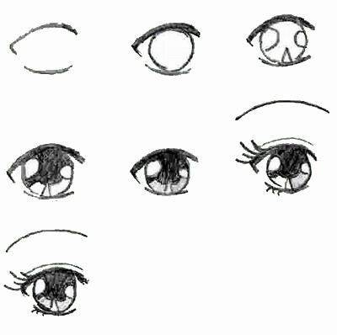

Slide 14
The journey begins long before myproduct.com/docs

Slide 15
Product Adoption Journey Applies to both Website and Readme.md
Exploration
Getting Started
OnBoarding/Problem Solving
Guidance/Discovery
Reference
Notes:
Documentation is part of the product process…

Slide 16
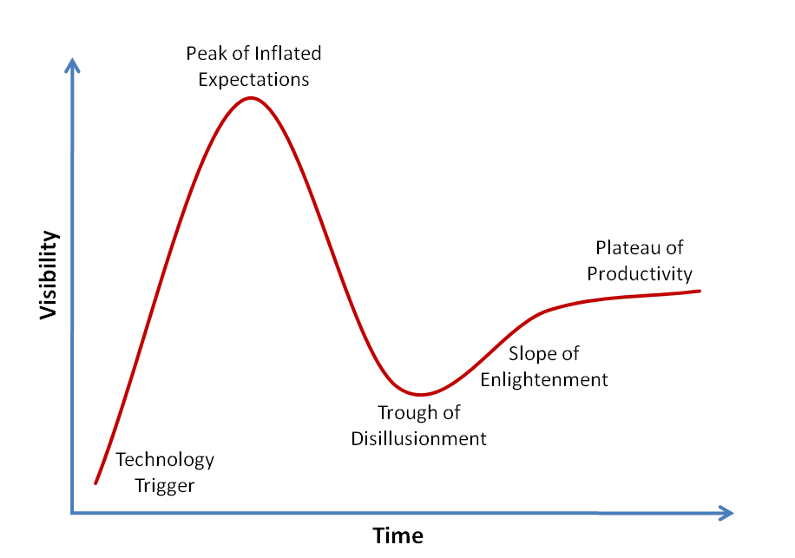

Slide 17
Exploration
Getting Started
OnBoarding/Problem Solving
Guidance/Discovery
Reference

Slide 18
Stage 1: Exploration

Slide 19
“Why should I care?”

Slide 20


Slide 21
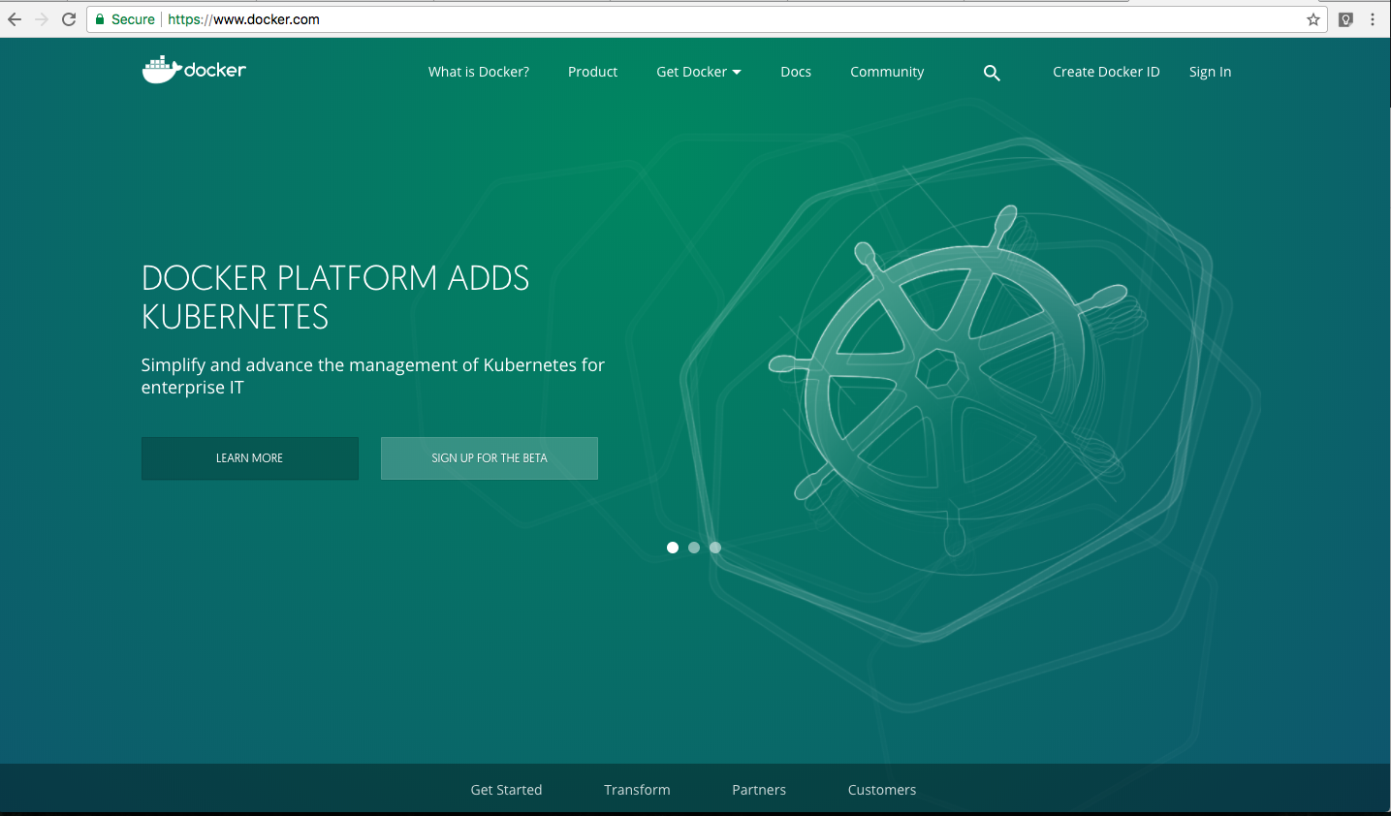

Slide 22
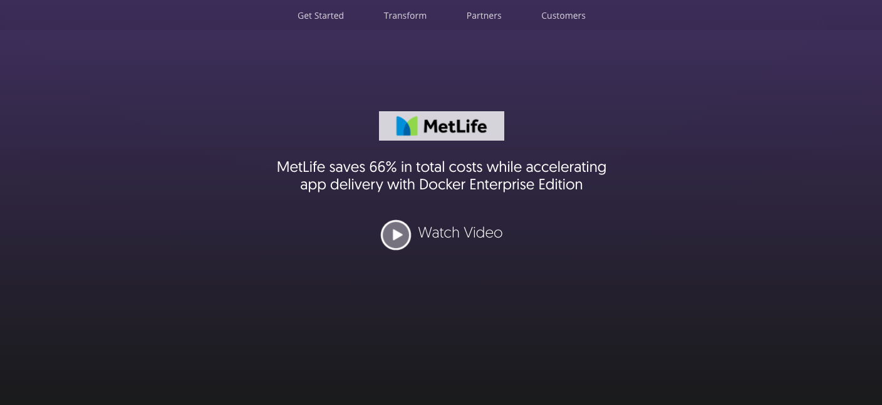

Slide 23
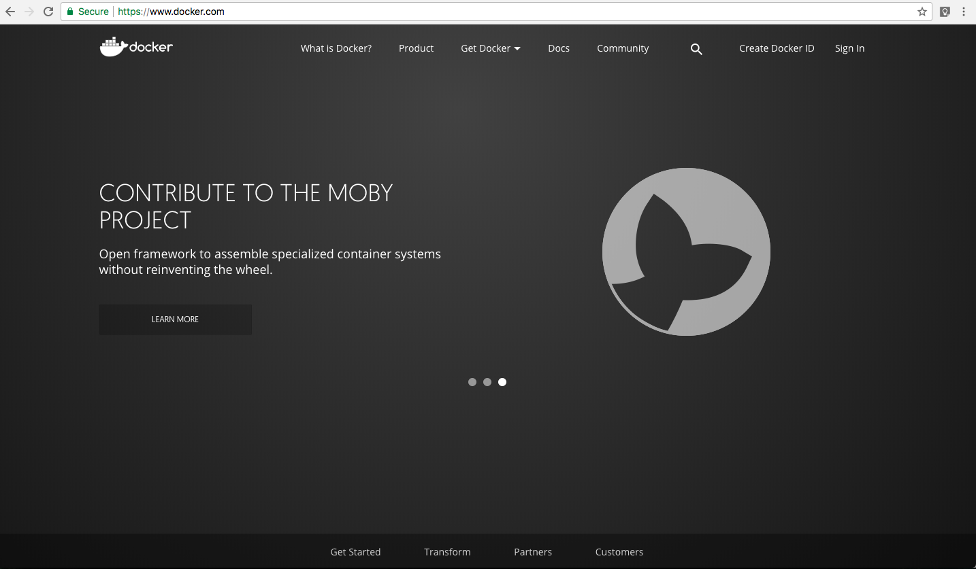

Slide 24
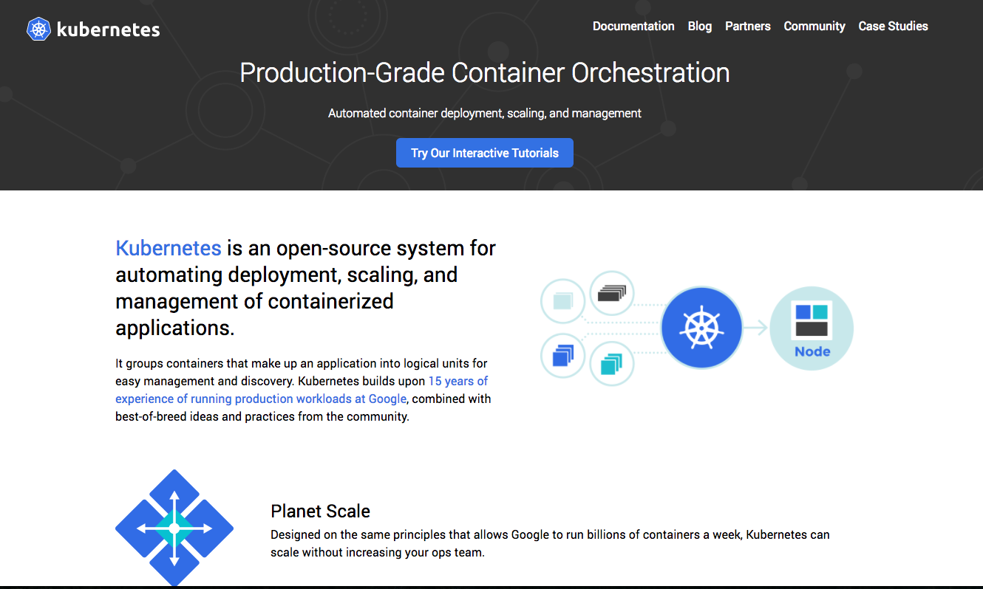

Slide 25
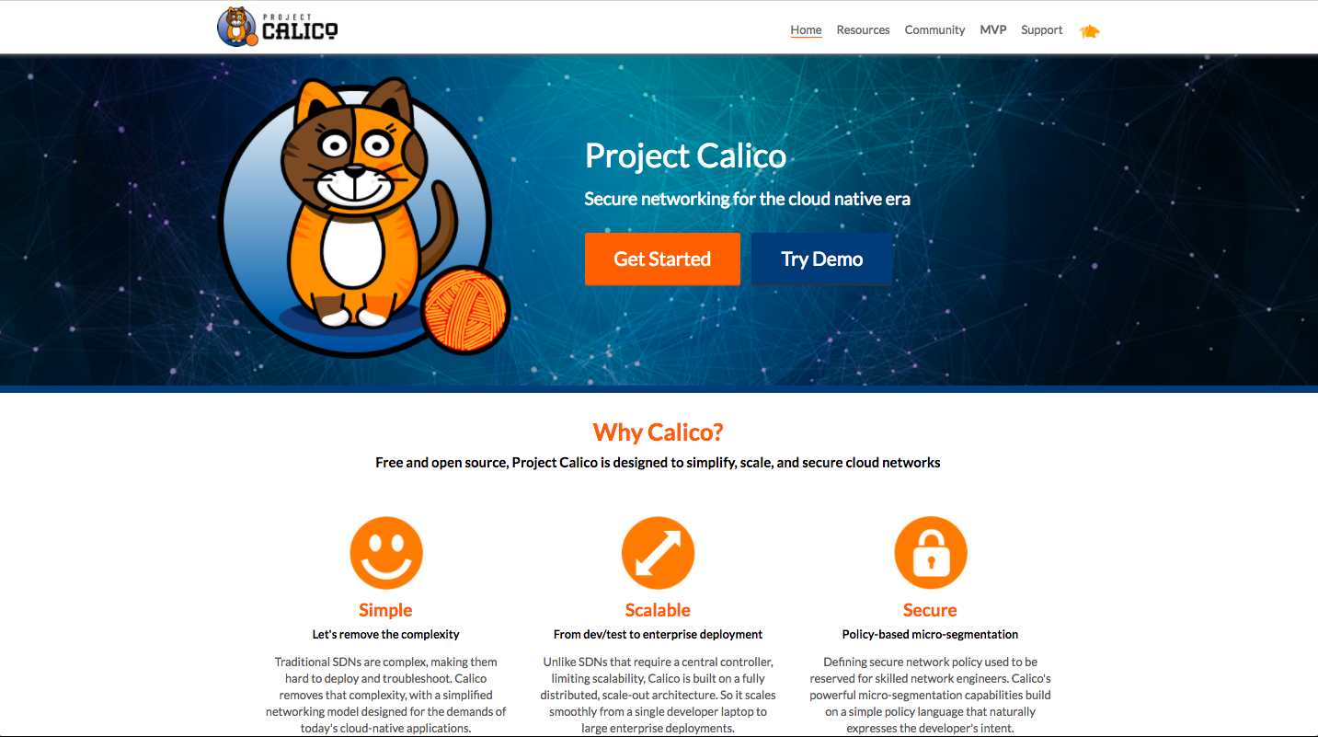

Slide 26
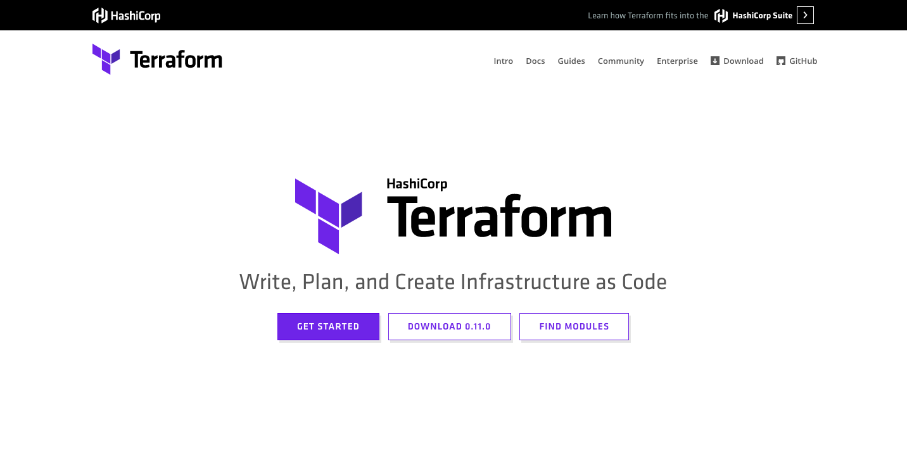

Slide 27
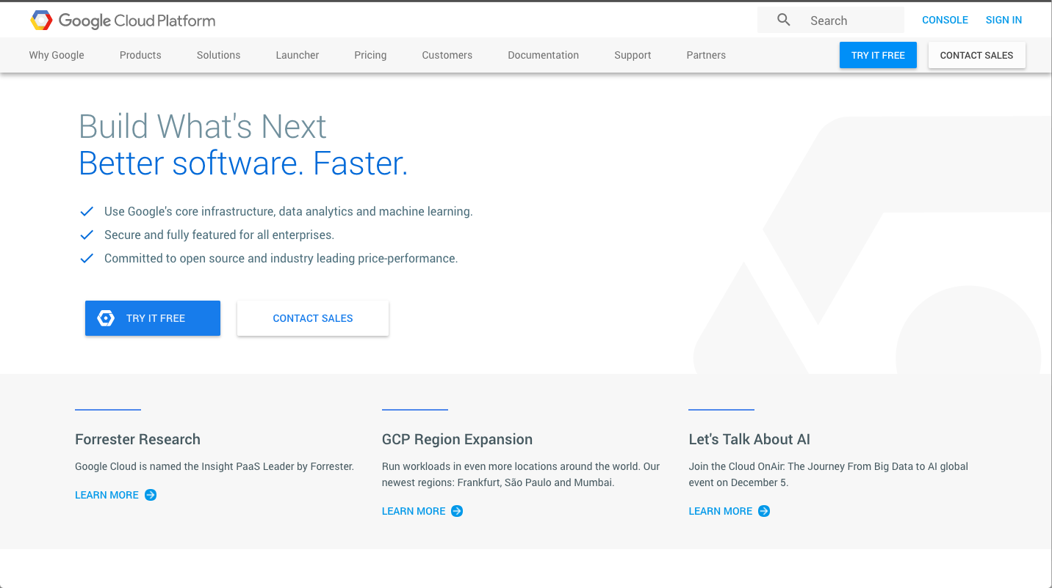

Slide 28
Stage 2: Getting Started

Slide 29
“Do you really solve my problem?”

Slide 30
“Download 10GB VM”

Slide 31
“Deploy using CloudFormation”

Slide 32
Asking for a large commitment before demonstrating you’re the right fit

Slide 33
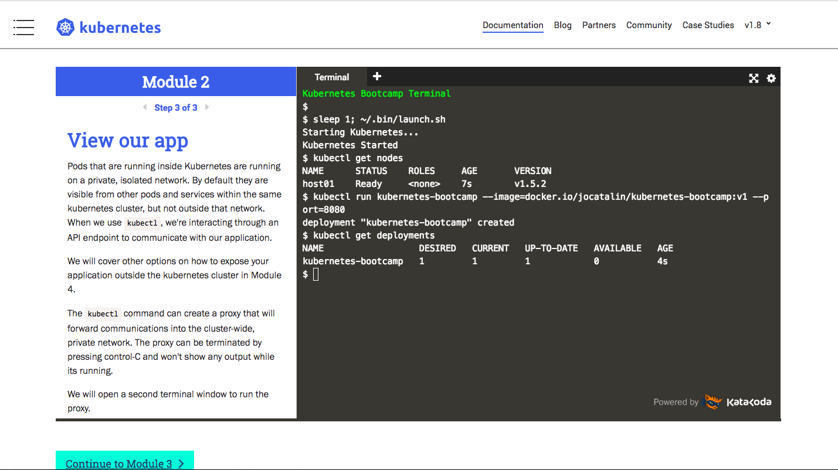

Slide 34
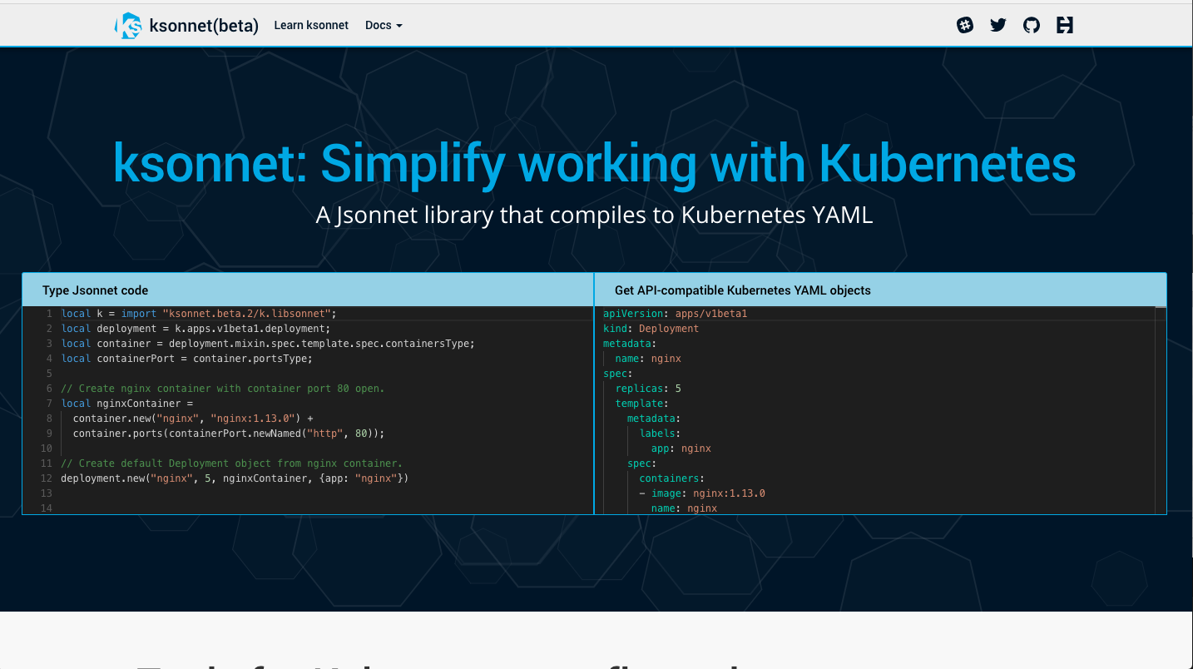

Slide 35
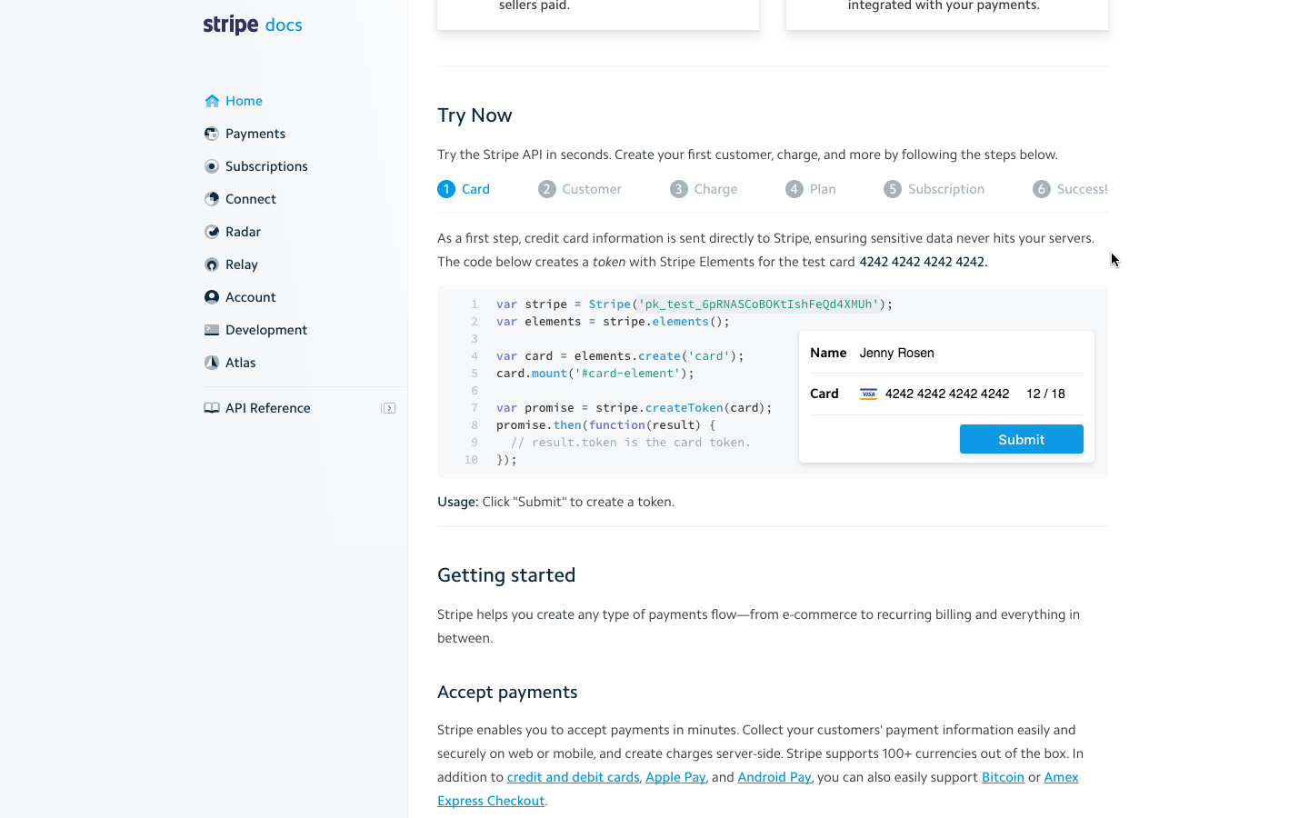

Slide 36
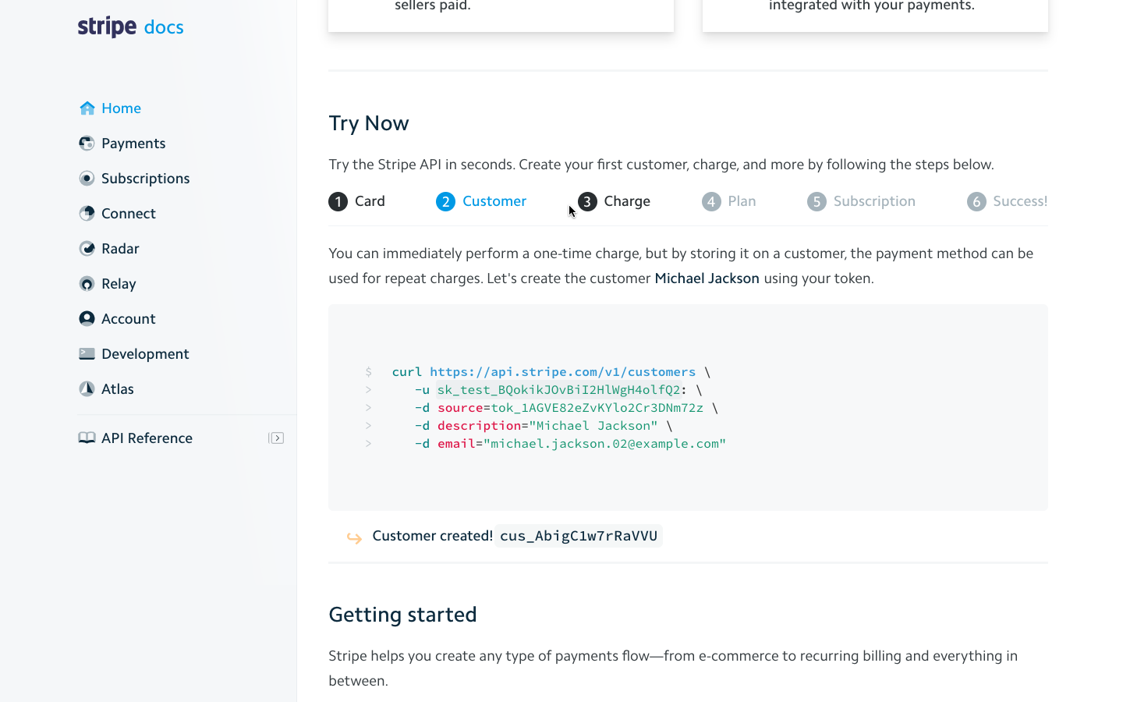

Slide 37
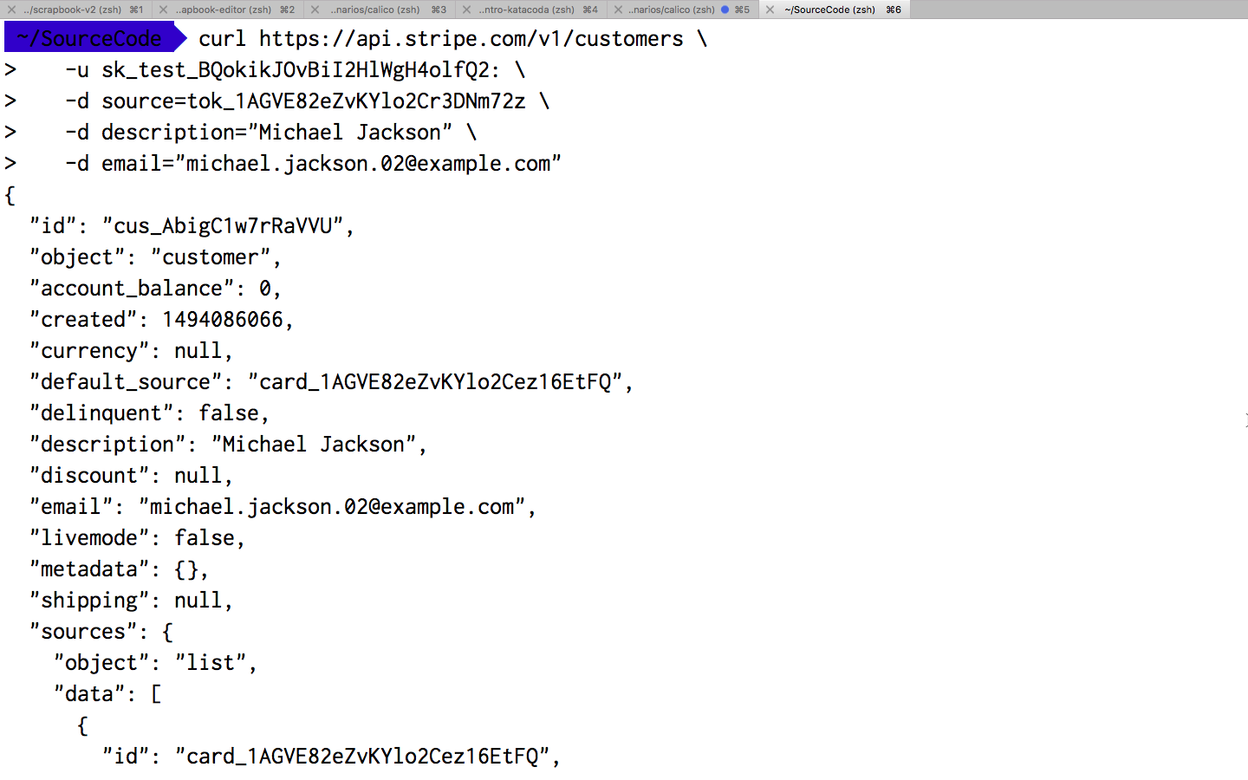

Slide 38
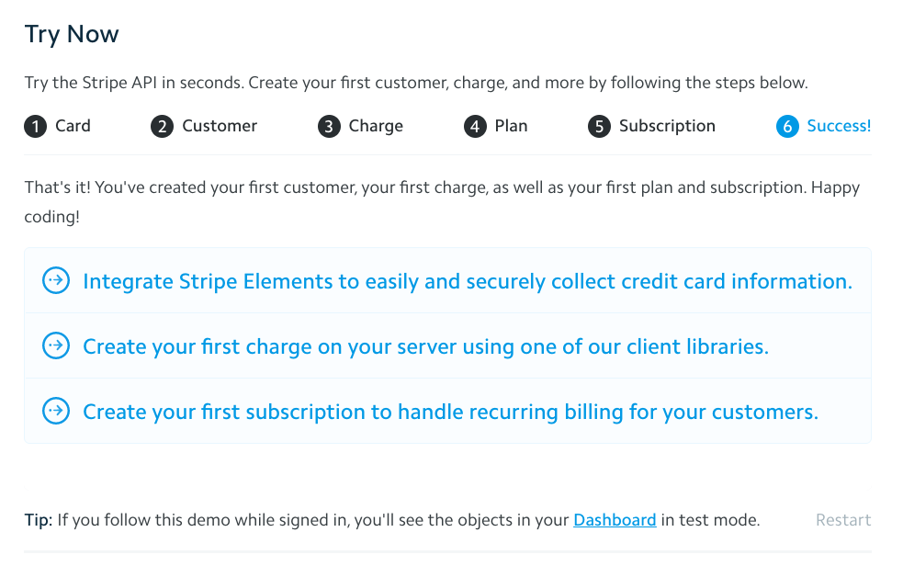

Slide 39
Do I have curl installed? What about mobile/iPad?
🤔

Slide 40
Users understand what your product does, and experienced the dream!

Slide 41
Stage 3: Onboarding

Slide 42
“Congratulations! I want to use your product”

Slide 43
The best documentation is the one we don’t have to write.

Slide 44

People don’t read on the internet
“He thinks he’s people!” (Archer)

Slide 45
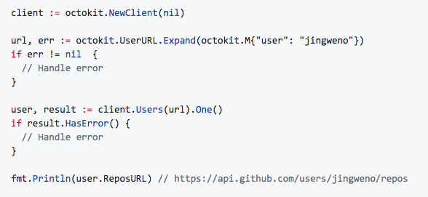

Slide 46
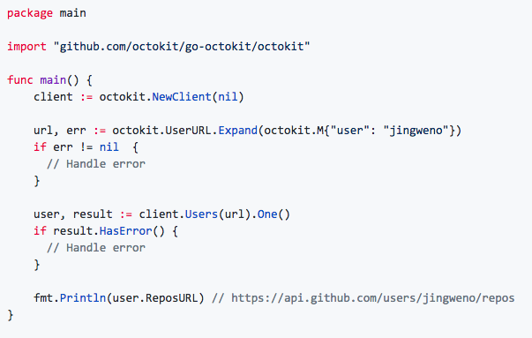

Slide 47
Show/Hide Headers Button

Slide 48
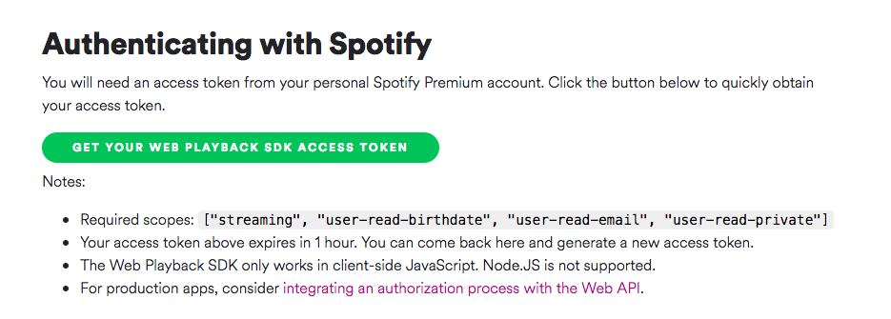
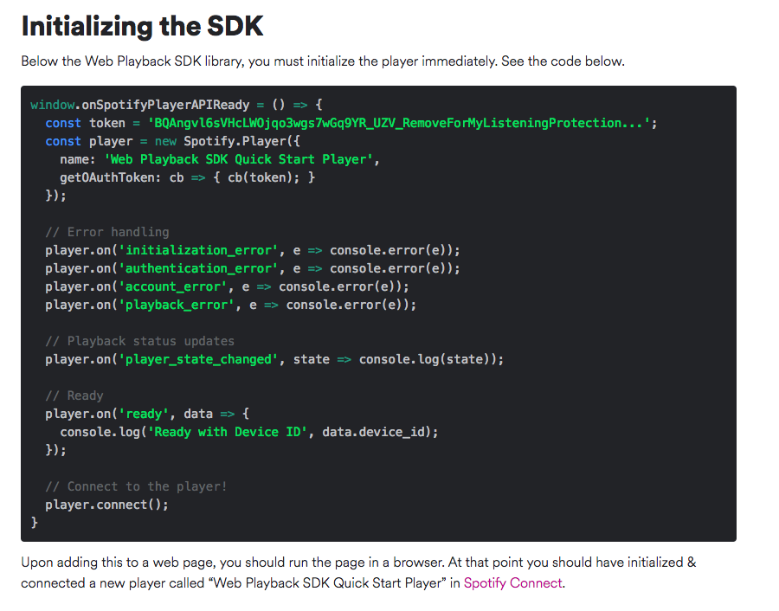
https://beta.developer.spotify.com/documentation/web-playback-sdk/quick-start/#initializing-the-sdk

Slide 49
Hard to document === missing developer UX?

Slide 50
Build tooling to help? Kubeadm
Why write documentation when you can automate it?

Slide 51
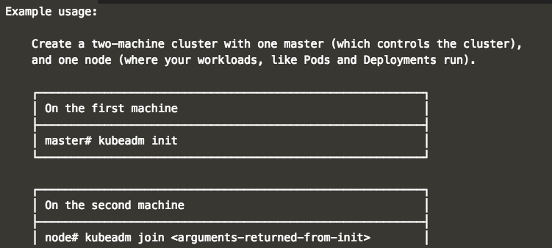
https://www.katacoda.com/courses/kubernetes/getting-started-with-kubeadm

Slide 52
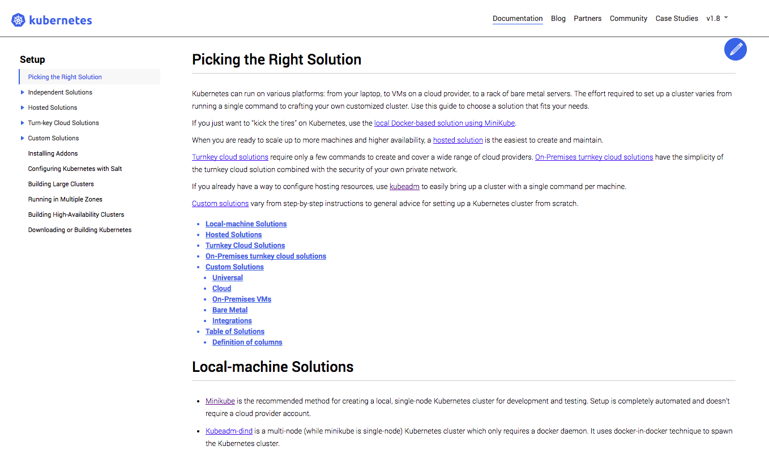

Slide 54
Stage 4: Guidance and Discovery

Slide 55
“Your product is solving my problem. What other problems can you solve?”

Slide 56
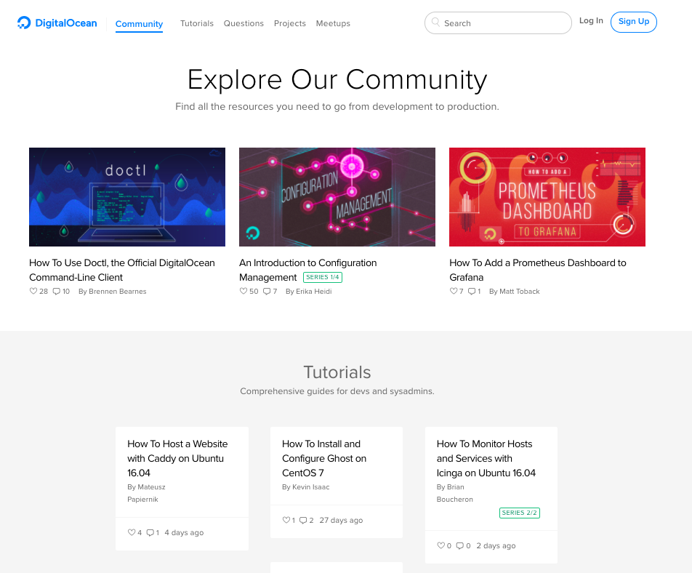

Slide 57
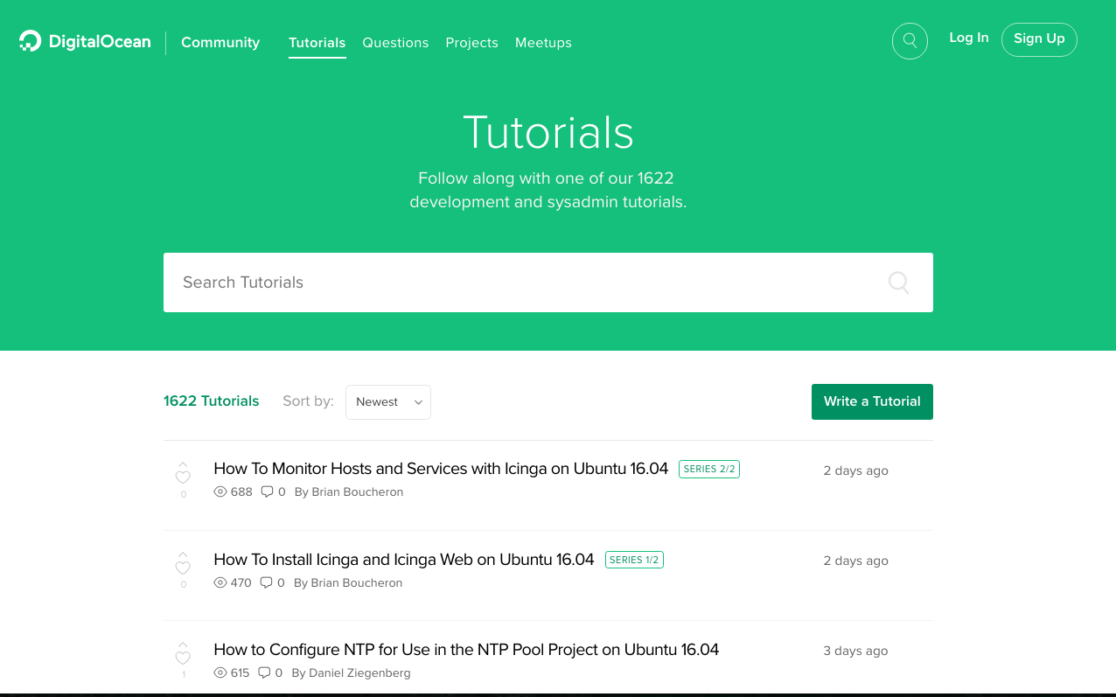

Slide 58
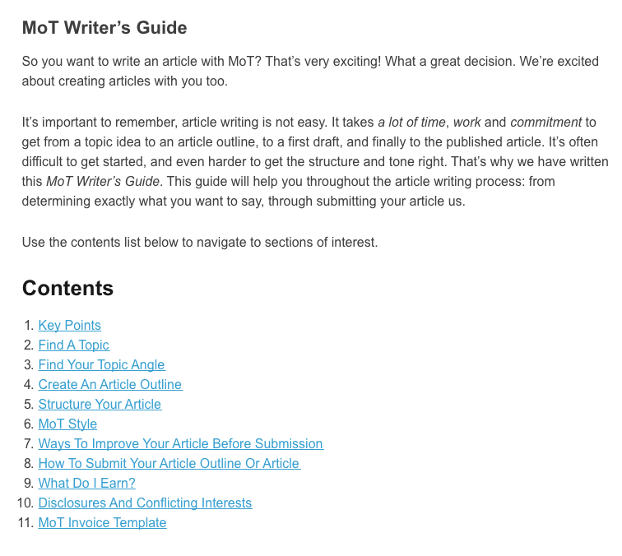

Slide 59
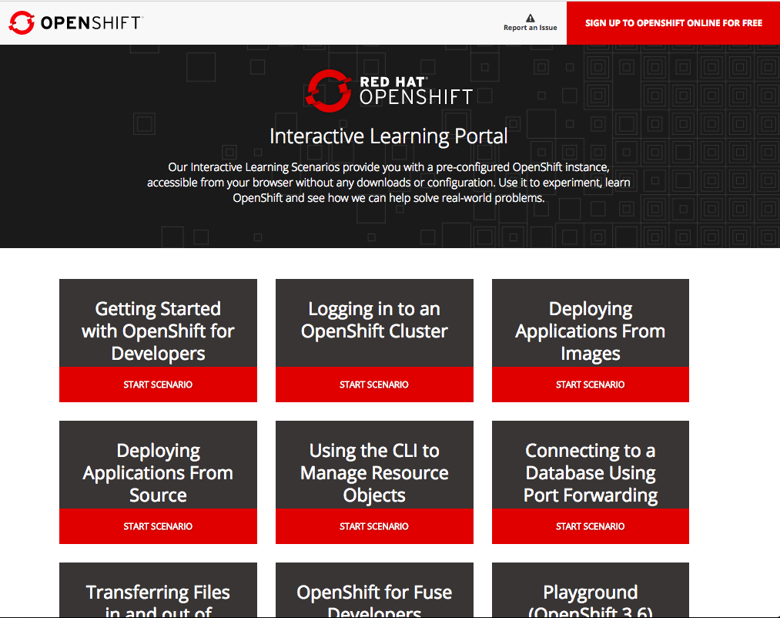

Slide 60
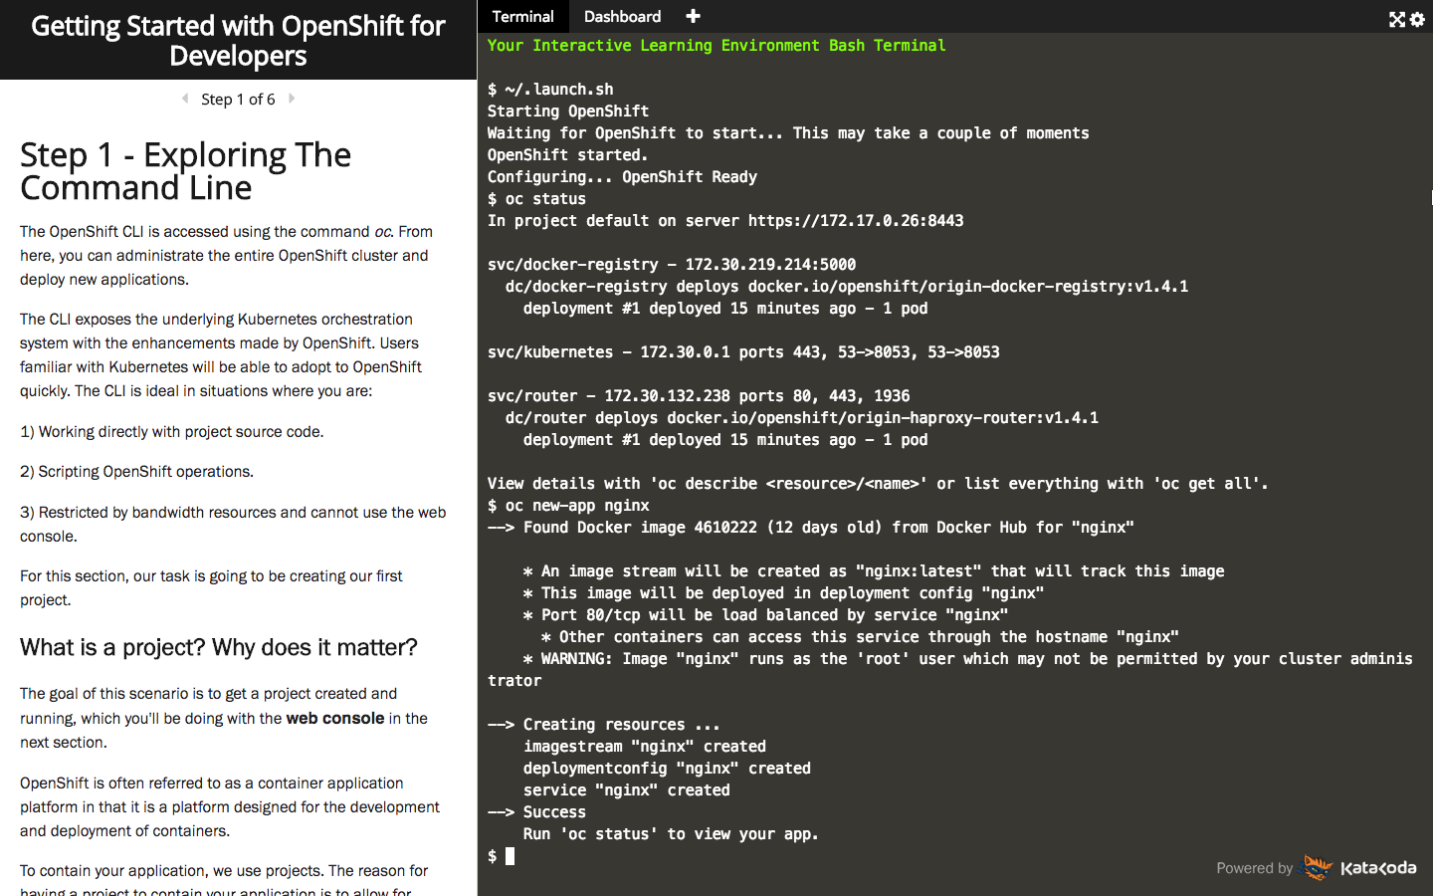

Slide 61
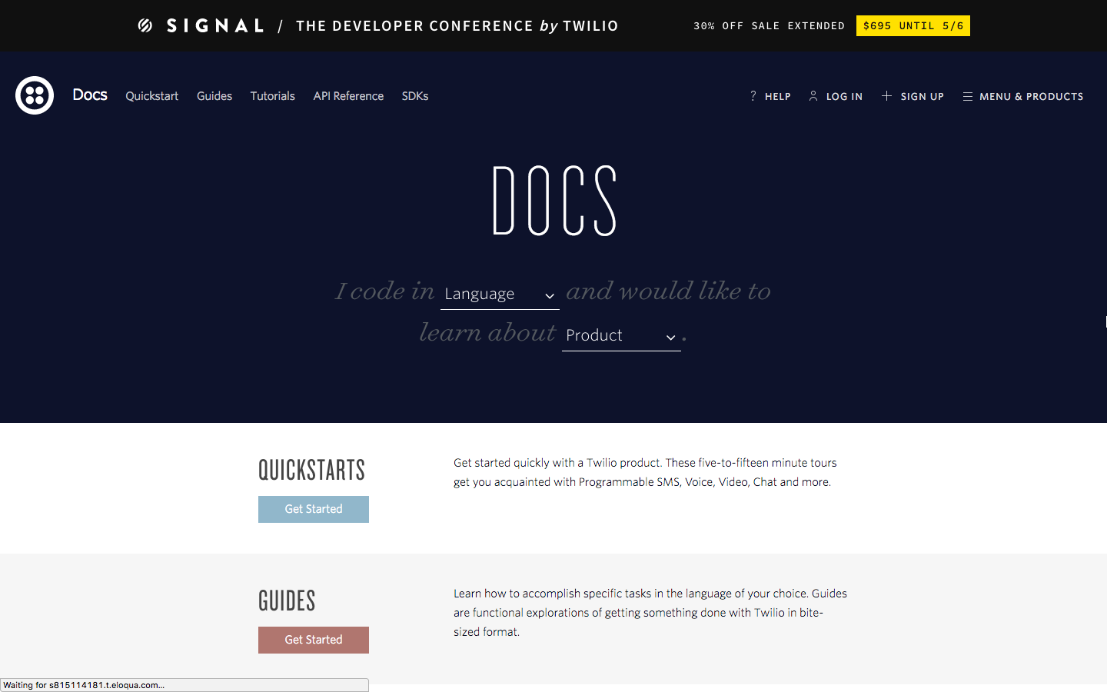

Slide 62
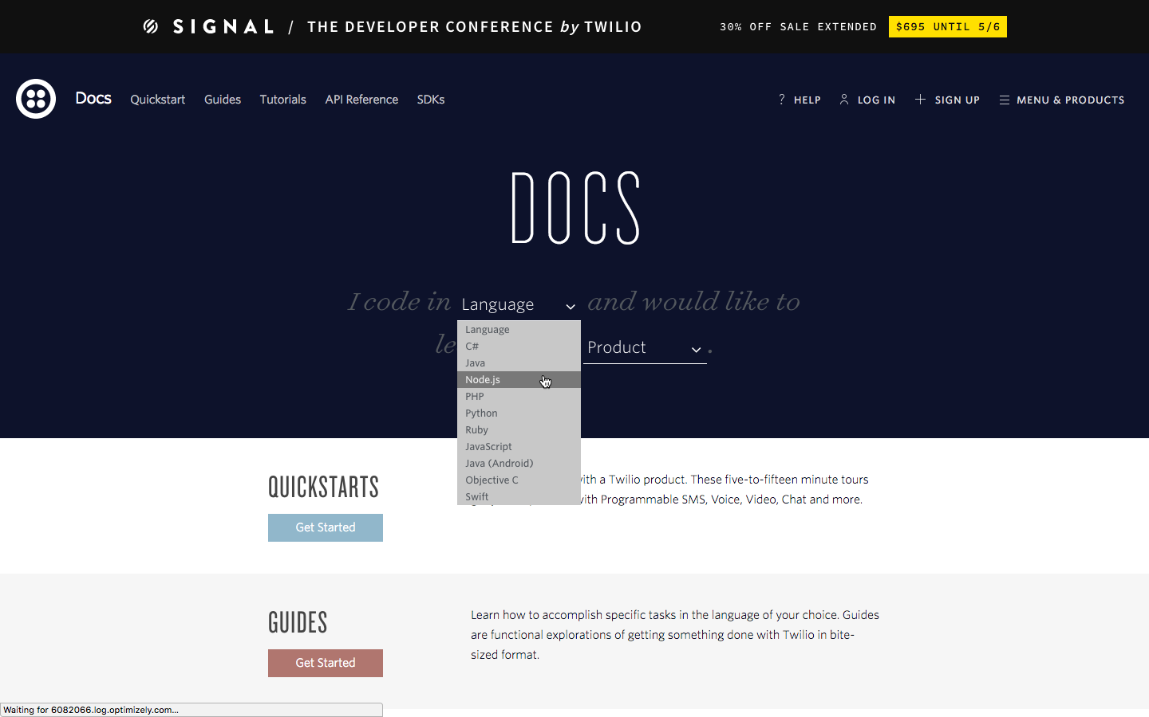

Slide 63
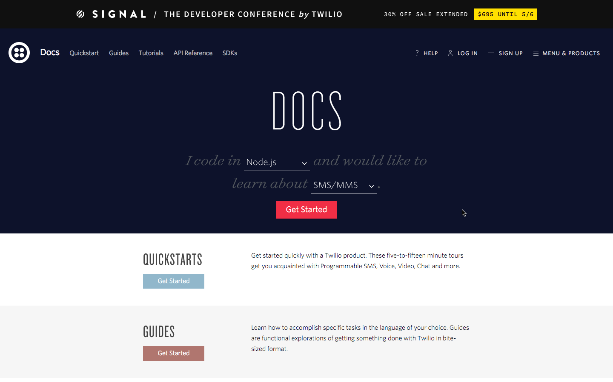

Slide 64
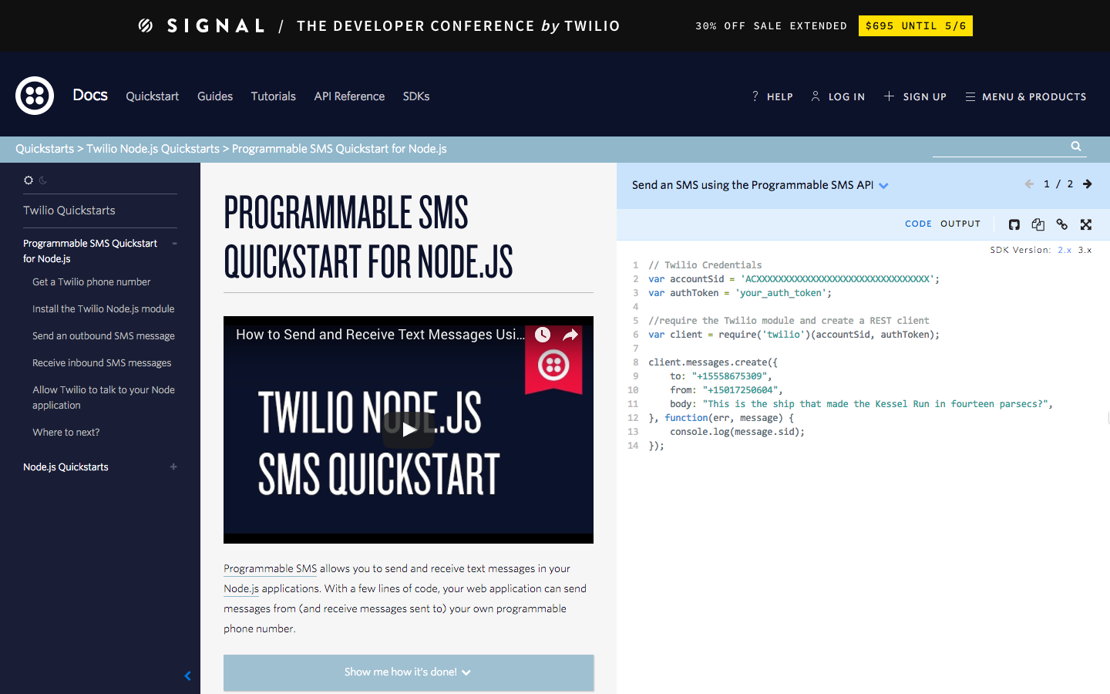

Slide 65
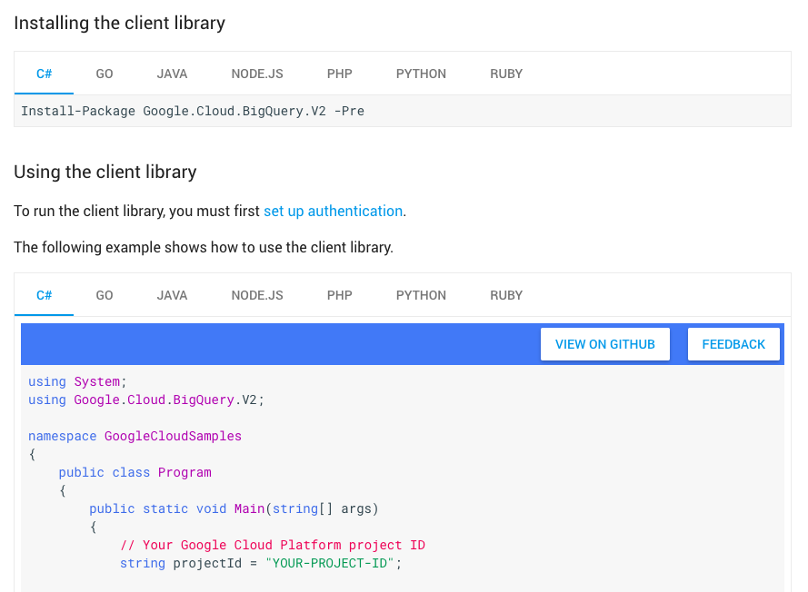

Slide 66
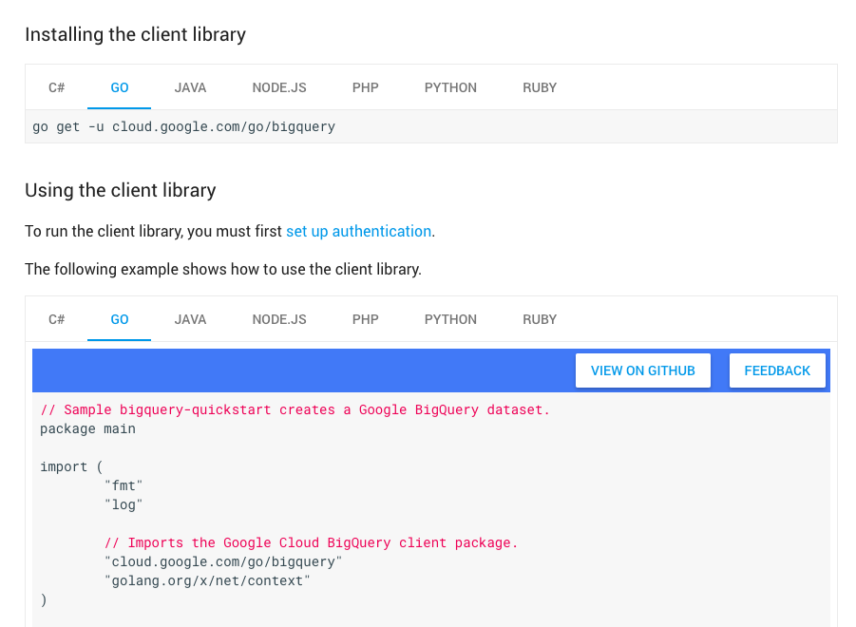

Slide 67
Stage 5: Reference

Slide 68
Becoming an expert…

Slide 69
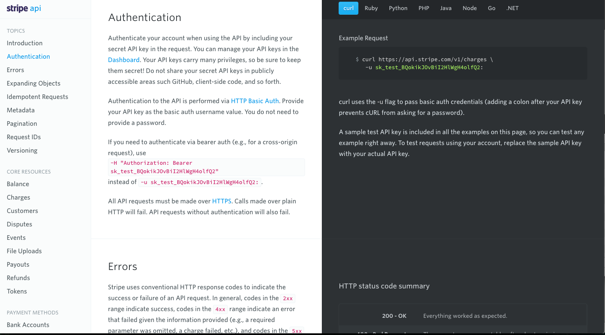

Slide 70
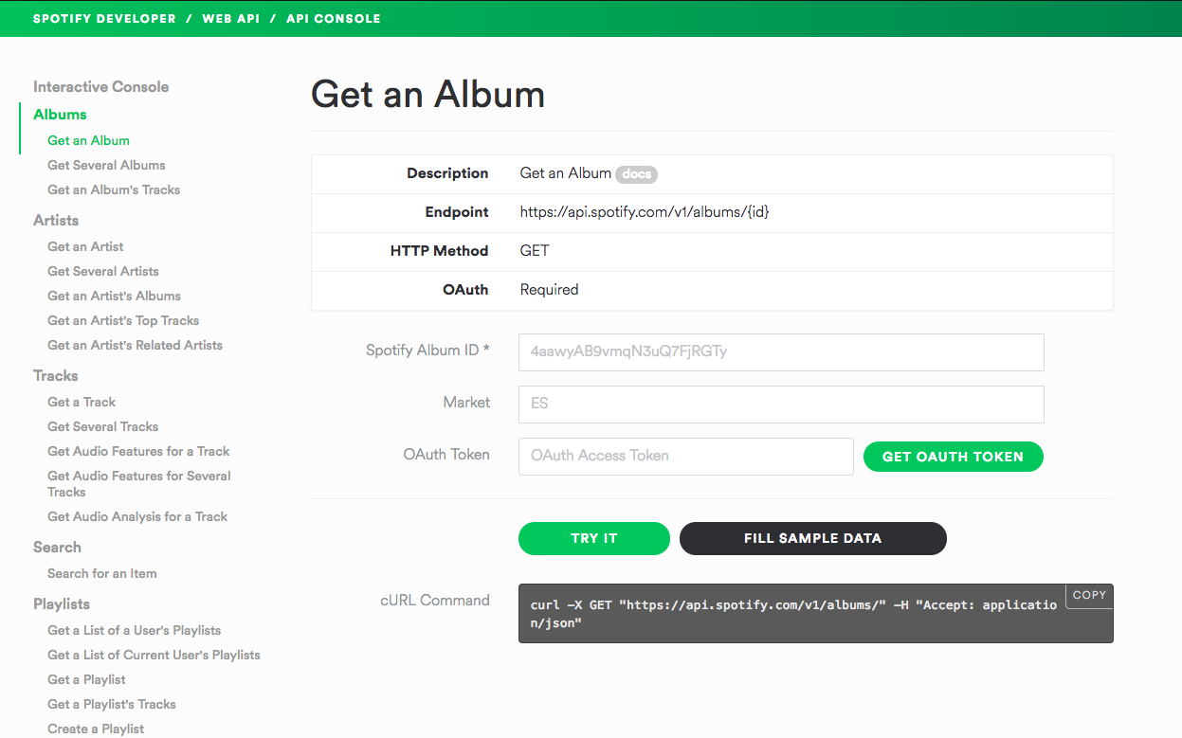

Slide 71
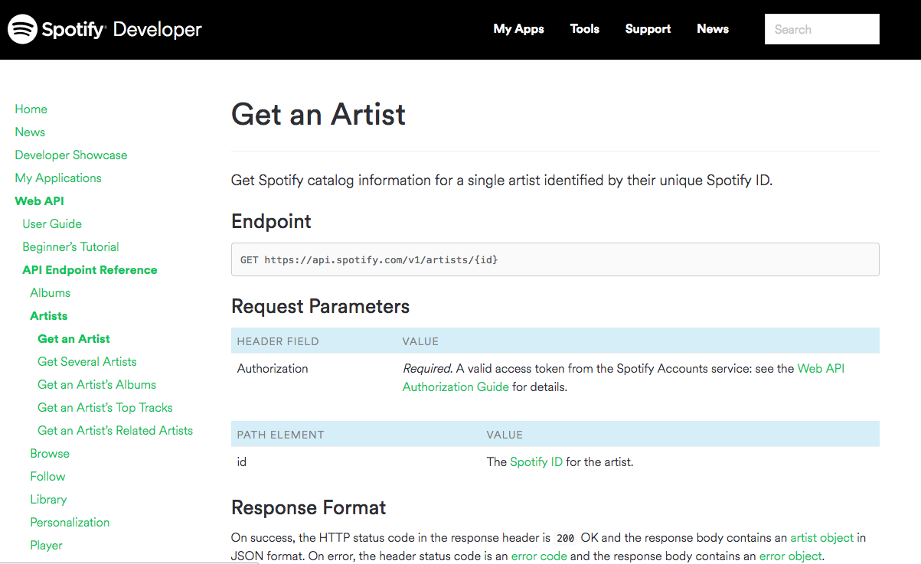

Slide 72
Exploration
Getting Started
OnBoarding/Problem Solving
Guidance/Discovery
Reference
Clear Project Definition
Interactive Demos/Examples
Low barriers to get started
Tutorials/Guides
Long Form Reference

Slide 73
But what about Readme.md?

Slide 74


Slide 75
Sets the tone

Slide 76
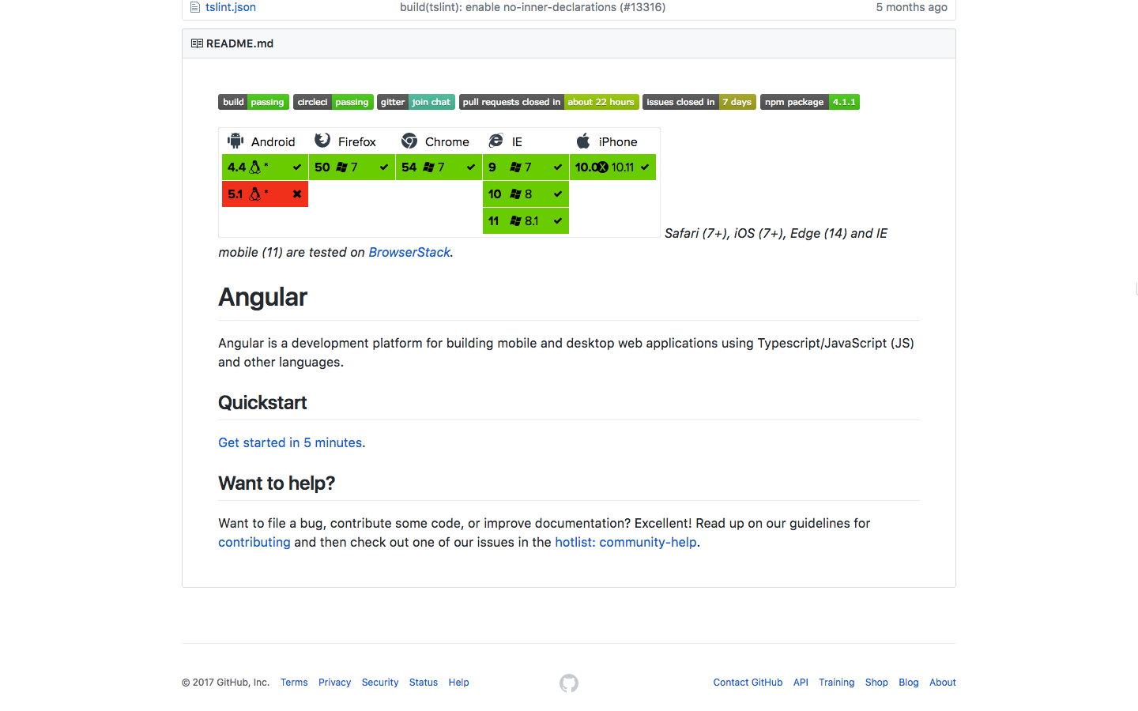

Slide 77
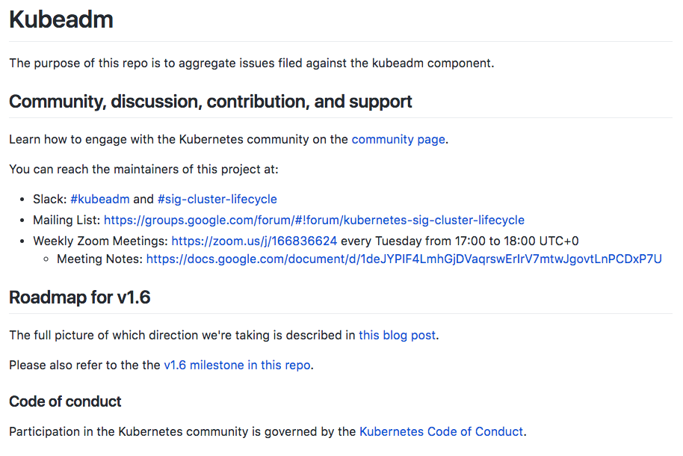

Slide 78
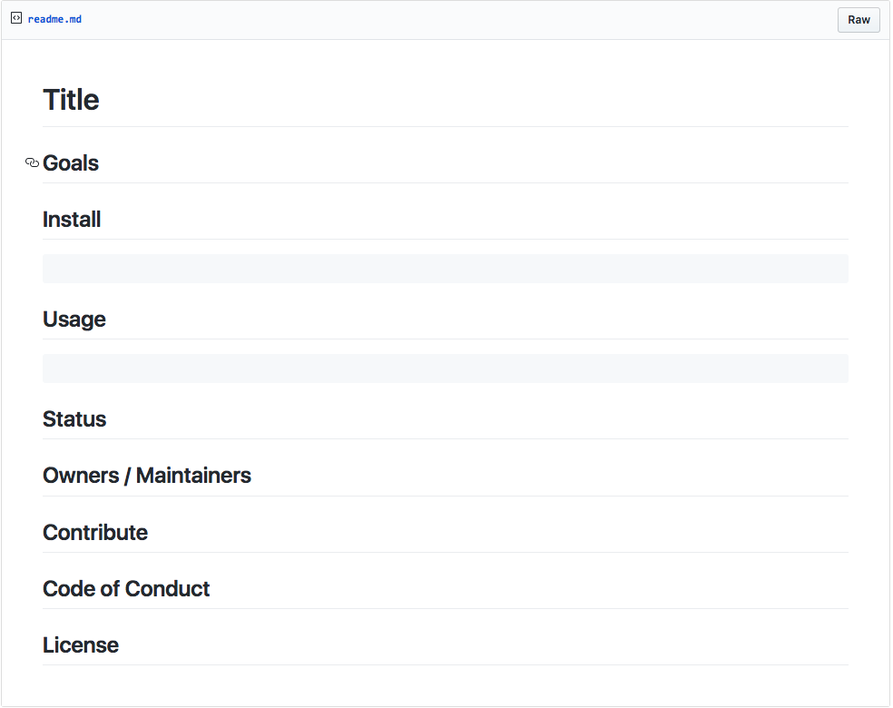

Slide 79
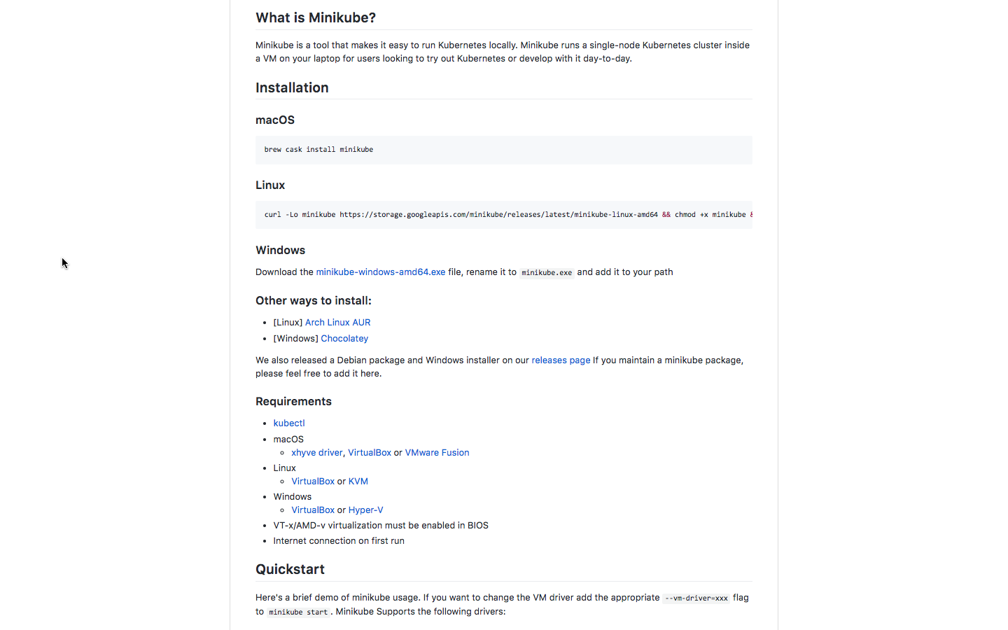

Slide 80
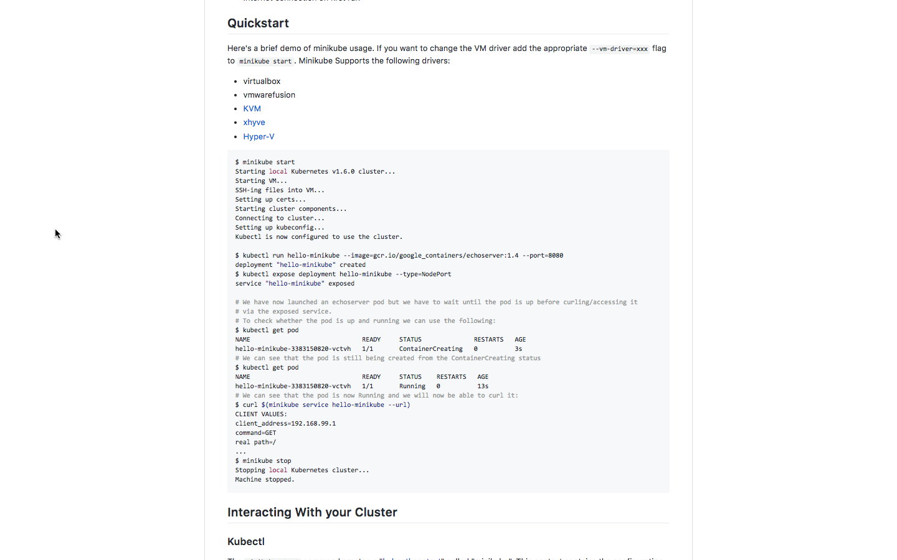

Slide 81
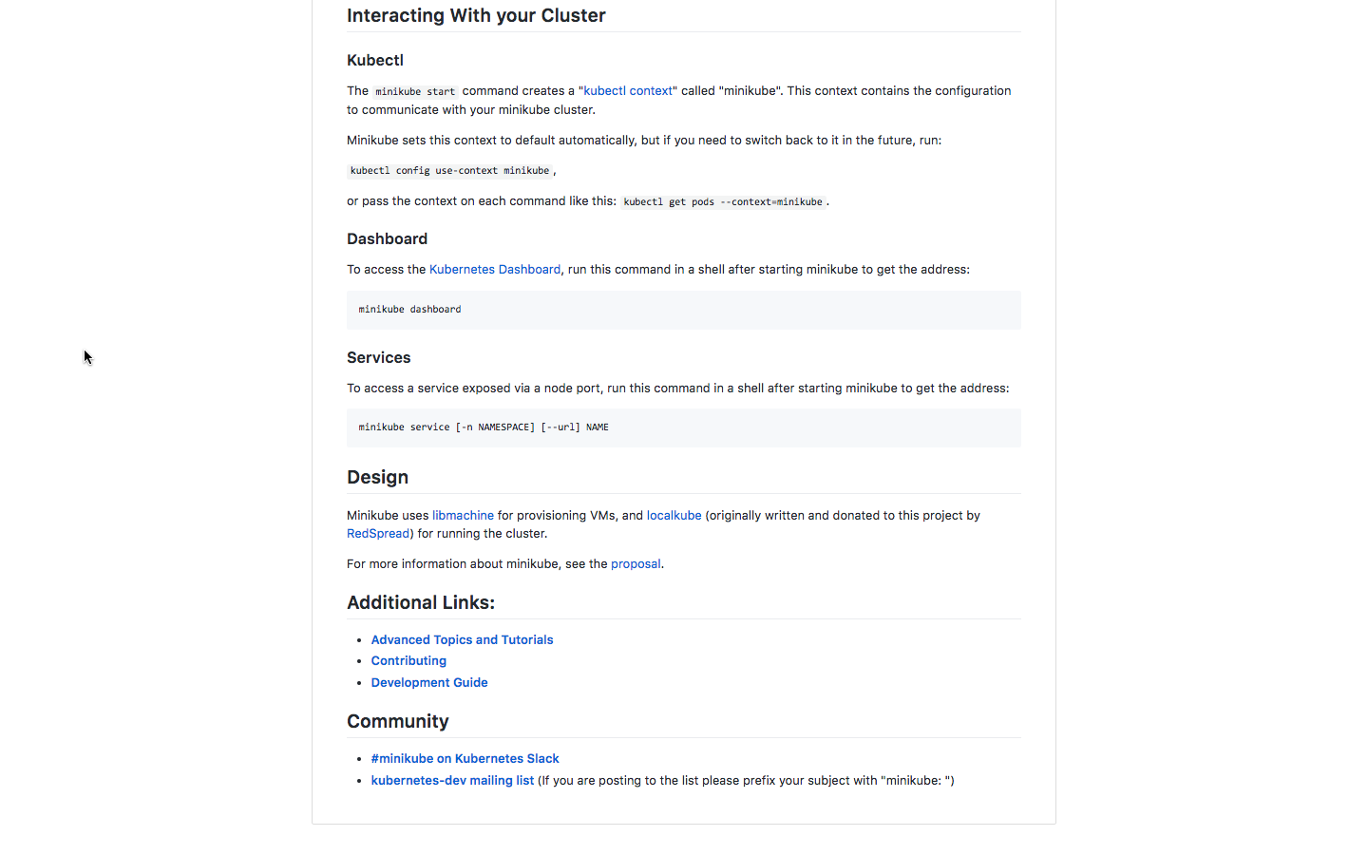

Slide 82
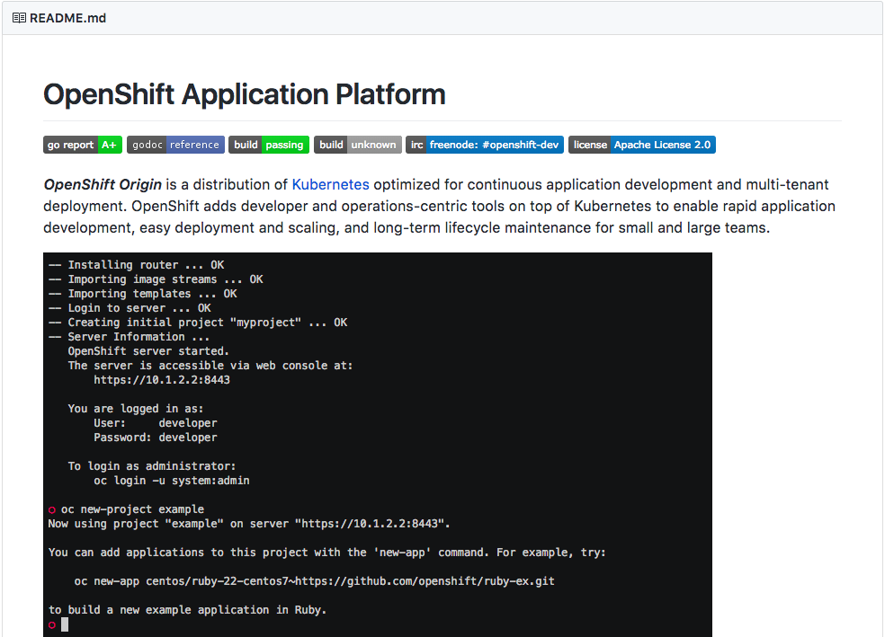

Slide 83


Slide 84

<details>
<summary><b>Examples</b></summary>
<ul>
<li>
<a href="./examples/json-body-parsing">Parse JSON</a></li>
<li>
<a href="./examples/urlencoded-body-parsing">Parse urlencoded form (html `form` tag)</a></li>
</ul>
</details>

Slide 85
Build it’s own community

Slide 86


Slide 87


Slide 88


Slide 89


Slide 90
Make it easy to provide feedback

Slide 91


Slide 92

Notes:
Blocker for people?

Slide 93
Who creates the “best” documentation?

Slide 94


Slide 95

@cbetta
betta.io
https://betta.io/blog/2016/12/14/what-developer-experience-could-learn-from-lego/

Slide 96



Slide 97


Slide 98


Slide 99


Slide 100


Slide 101


Slide 102



Slide 103

Thank you
@Ben_Hall
Ben@BenHall.me.uk
Blog.BenHall.me.uk
www.Katacoda.com

